Slide 1
File Permission
Chmod command

Slide 2
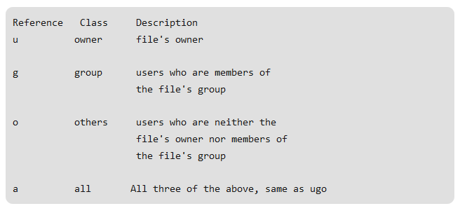

Slide 3
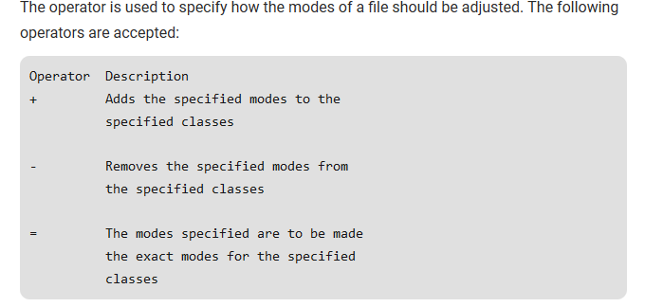

Slide 4
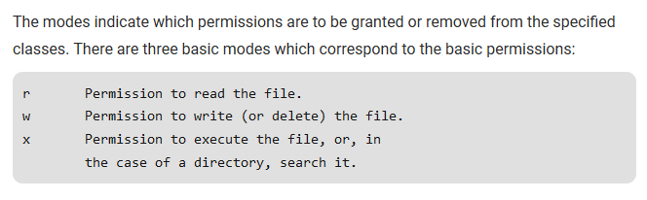

Slide 5
Numeric code
A numeric mode is from one to four octal digits (0-7), derived by adding up the bits with values 4, 2, and 1. Any omitted digits are assumed to be leading zeros. The first digit selects the set user ID (4) and set group ID (2) and sticky (1) attributes. The second digit selects permissions for the user who owns the file: read (4), write (2), and execute (1); the third selects permissions for other users in the file's group, with the same values; and the fourth for other users not in the file's group, with the same values.

Slide 6
Symbolic mode
The format of a symbolic mode is '[ugoa...][[+-=][rwxXstugo...]...][,...]'. Multiple symbolic operations can be given, separated by commas. A combination of the letters 'ugoa' controls which users' access to the file will be changed: the user who owns it (u), other users in the file's group (g), other users not in the file's group (o), or all users (a). If none of these are given, the effect is as if 'a' were given, but bits that are set in the umask are not affected.

Slide 7
Cut command
The cut command in UNIX is a command for cutting out the sections from each line of files and writing the result to standard output. It can be used to cut parts of a line by byte position, character and field. Basically the cut command slices a line and extracts the text. It is necessary to specify option with command otherwise it gives error. If more than one file name is provided then data from each file is not precedes by its file name.
Syntax: cut OPTION... [FILE]...
Example: cat state.txt
Andhra Pradesh
Arunachal Pradesh
Assam
Bihar
Chhattisgarh
cut -b 1,2,3 state.txt

Slide 8
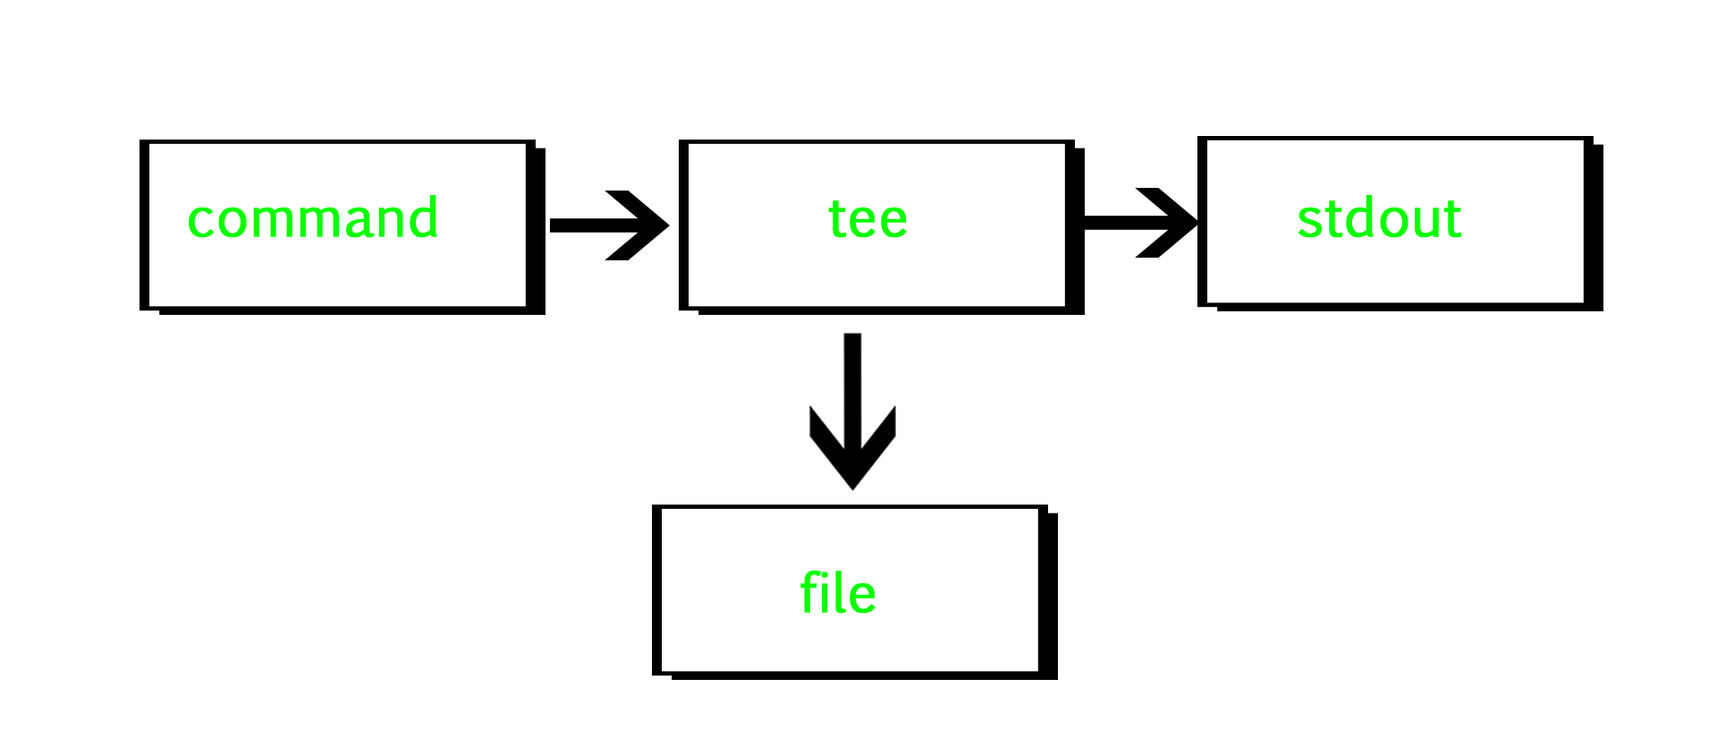
Tee command
tee command reads the standard input and writes it to both the standard output and one or more files. The command is named after the T-splitter used in plumbing. It basically breaks the output of a program so that it can be both displayed and saved in a file. It does both the tasks simultaneously, copies the result into the specified files or variables and also display the result.

Slide 9
Syntax:
tee [OPTION]... [FILE]...
Example:

